Slide 1


Game Strategy
TEAM 4150

Slide 2
Overview
Kickoff Discussion
Board Game
Watching other competitions
Competition

Slide 3
Kickoff Discussion
You won’t fully understand the game at this point, and that’s okay. Right off the bat, the most important things to look at are:
How points are scored
How ranking points are earned
What general types of robots there will be
In Destination: Deep Space, there were hatch panel bots, cargo bots, tall bots, short bots, climbing bots, etc.
This will help when conceptualized what types of bots can be on each alliance and how they will all play.

Slide 4
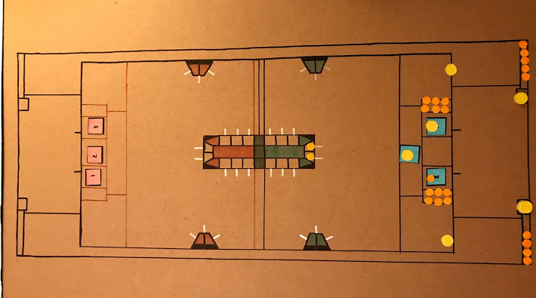
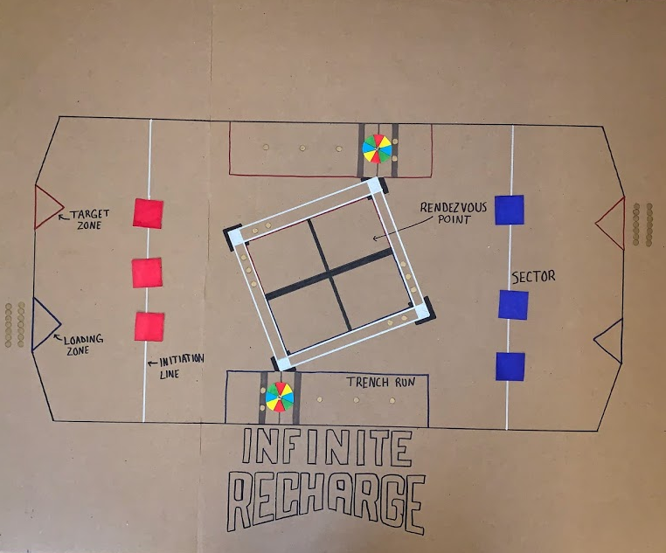
Board Game
Great way to visually play out a game.
Helps place a more realistic spin on the game to understand where everything is located
Make sure to draw to scale - we use 2ft:1in
Great for planning strategy with other teams. Easy draw out where you and the other robots will be.
You can keep it in your pit at competition.

Slide 5
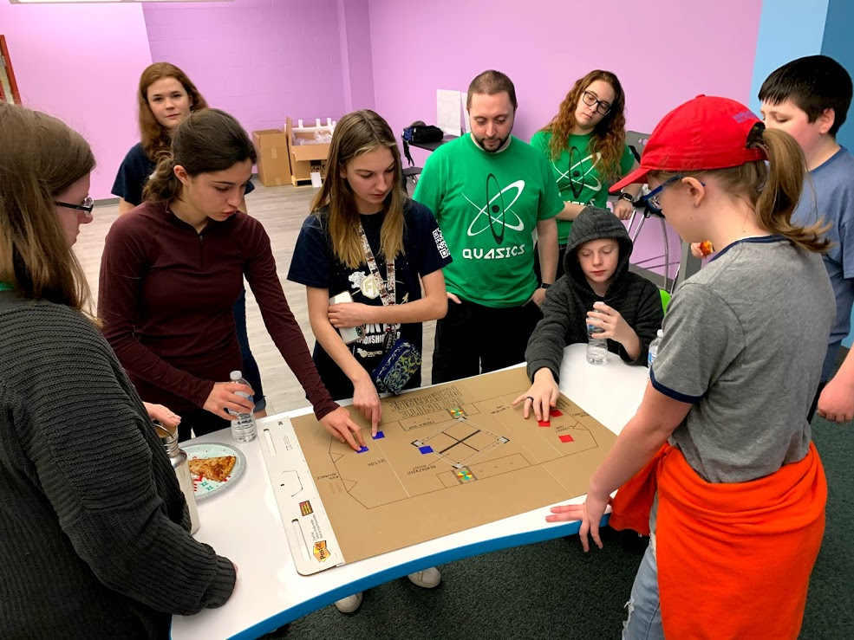
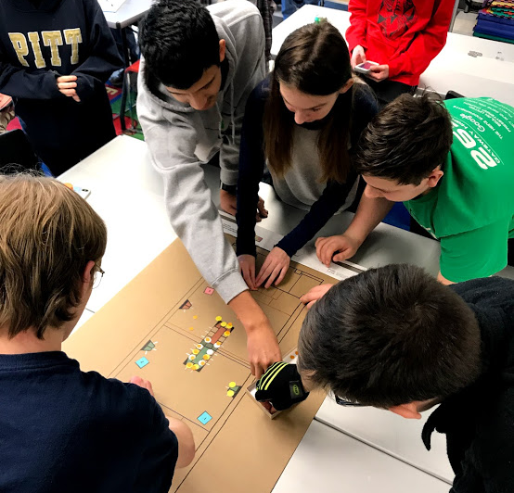
Board Game Cont.
Throughout the season, we play the board game with our scouts, drive team, and even other teams. The players keep track of their robots capabilities and how much it can score in one match.
Here are the board games in action! Shoutout to FRC 2656 & FRC 8133 for playing with us.

Slide 6
Watching other competitions
While you have probably spend hours discussing the best strategy and how you think the game will be played, you will never know until the actual competition.
To avoid any surprises, watch matches from other competitions happening before your event!
Even if you are competing in week 1, there are often scrimmages beforehand to watch.
Be as educated as you can be going into your event.

Slide 7
The key to success at competition is
communication!
All of the following slides discuss strategies to succeed at competition, but they are all based on communicating with your team, scouts, drivers, coach, and alliance.

Slide 8
Competition - General Match Tips
Always walk into match with a plan. Without a plan, robots could cluster up, get in each other's way, and possibly get damaged.
Maximize time on the field. Time flies, so make sure that every action you take is contributing towards the alliance’s success for the match.
Adapt. While you can walk into a match with the perfect plan, you never know when problems may occur. This is where your back up plans will come in. In a pinch, continue with what the drive coach thinks is the best action for your team.
Keep your robot in good condition. Robots do break or malfunction during matches! Make sure to be proactive about fixing potential problems before you get on the field.
Have a post-match team meeting. The drive team and scouts should communicate what went well and what didn’t, and what needs to change for the next match. During playoffs, this meeting should include the alliance partners.

Slide 9
Competition - Before the match
Your robot
While it’s awesome to think you robot can do everything, be modest and honest about your capabilities.
Know what you do best.
Be flexible and fill in where your alliance needs you (within your capabilities).
Your alliance partners
Consult your scouts to make sure the information the other team is telling you is consistent with their past performances.
Try to have them play to their strengths; If everyone on the alliance does what they do best, the alliance is more likely to succeed.
Your opponents
Consult with scouts to try and identify what each of the other robots will most likely do (high scoring robot/where they score/defense robot).
Knowing this information will help you and your alliance gauge how you should play and what each robot should do.
If you can walk into a match knowing what the opponent will do, it greatly helps your chance of success.

Slide 10
Competition - Qualification Matches
“How can I maximize ranking points during this match?”
In quals, you play to gain ranking points to try to get into the elimination rounds. (The more ranking points you have the more likely you are to be an alliance captain and/or to be selected for another alliance).
In these matches, you will be playing with and against almost every other team. Thus, in some matches your alliance will be strongly suited to play the game and weak in other matches.
When looking at how you and your alliance should play each match, work together towards the easiest ranking points. This can come in the form of winning the match or performing other actions on the field again- your alliance should try to complete what is easiest for itself. Each member of the alliance should be honest about their strengths and weaknesses so that you can build a strong game strategy together.
Note: Remember to try and show of your robot’s best traits. By doing this, you show other teams how good your robot can be and can help you get selected during alliance selection.

Slide 11
Competition - Playoffs
If you make it to playoffs. congrats!! This is a big achievement and means that you are one of the top robots at the event.
The game changes drastically from qualification rounds. In playoffs, teams win and lose based on points, so forget everything about earning ranking points.
When forming a strategy in this stage of the game, you want to focus on how your alliance can out-score the other alliance. This usually is comprised of some robots scoring while others play defense.
In playoffs, it’s even more important to discuss with your alliance each of your robots’ strengths and try to compose a fluid strategy to victory.
Map out each stage of the game and the general area each robot will be in:
Autonomous: what are we doing
Teleoperated period: where are we going to be and moving to and from
End game: who is going where and in what order
This minimizes traffic jams! Some matches come down to just 1 point, so communicated the plan beforehand is extremely important.

Slide 12
Competition - Playoffs
During planning make sure to think about what the other alliance will do - they are also trying to win! Predict what they may do so you can create back up plans. Nothing is more deteriorating when you walk in with a plan and it gets stumped and you have nothing to fall back on.
During the match, stay proactive. Make the most of your time on the field. If this means you deviate from the plan it is okay, just make sure you know what you are doing and that it will help the team out score the other alliance.
Winning your first playoff match: that means your strategy was successful! However, this does not mean it will work the next time. Before your next match, fix up the robot and talk about backup plans for if the other alliance tries to throw something new at you and what you can improve overall. You can never be over prepared.
Losing your first playoff match: don’t give up hope. This is the best time to look back at the match and see were you fell short. During this time, you want to analyze what the opponent did and how you can try to prevent them from doing the same thing again. This is the time to get a little creative-- it’s only 1 more match until you’re out-- so it’s okay to try mixing up which robot does what and who is going where. The best thing you can do is try something new that the other alliance isn’t expecting you to do.

Slide 13
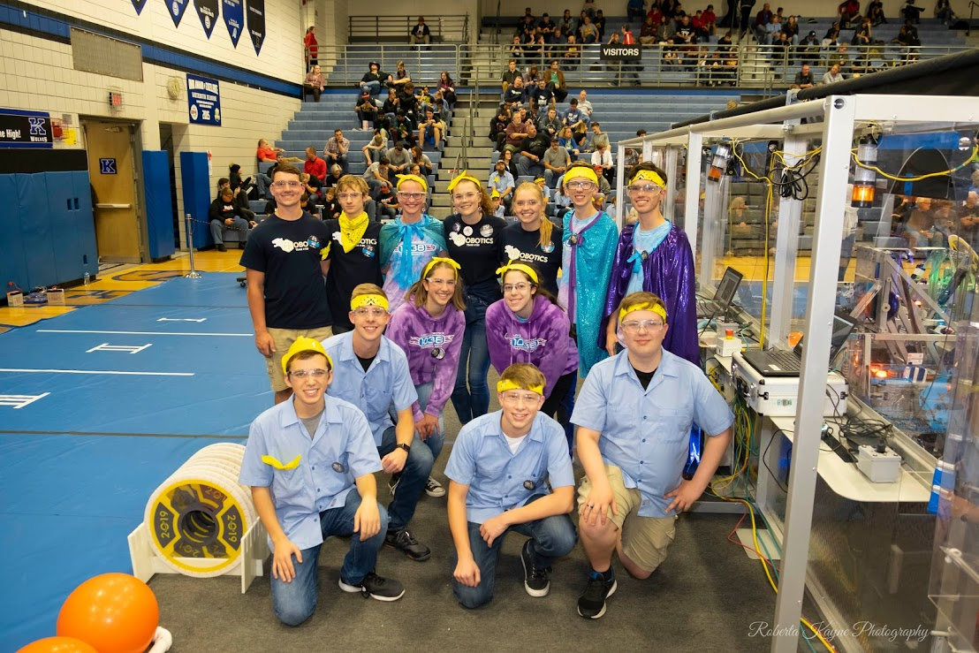
Alliance Spirit
Always practice Gracious Professionalism when interacting with your alliance partners, and have some fun! Especially in playoffs, you need to get to know your partners really fast so that you can work together better. Learn each others’ handshakes and do them as an alliance (rather than each team alone), spend time together between matches, and swap team pins/keepsakes. This will help you perform better as an alliance!
Our winning alliance at CORI 2019 wearing our team’s signature yellow bandanas! We also swapped pins and learned each others’ handshakes. (Thanks to FRC 1038 and FRC 3484!)

Slide 14

Credits
This lesson was written by FRC 4150 in partnership with FRC 8027 for FRCTutorials.com
You can contact the author at froboticsteam4150@gmail.com.
More lessons for FIRST Robotics Competition are available at www.FRCtutorials.com
This work is licensed under a
Creative Commons Attribution-NonCommercial-ShareAlike 4.0 International License.

